Slide 1

Machine Learning Engineer in the Generative AI Era
Week 6 – Supervised Fine-Tuning (SFT) Part II

Slide 2
Agenda
Ensuring Diversity in SFT Data (Human & Model)
Synthetic Data Generation Techniques
Data Quality Assurance Methods
Leveraging LLMs as Judges & Rejection Sampling
LLMsys Arena & Elo Rating System for Evaluation
Project 6 Overview & Next Steps

Slide 3
Importance of Diversity in SFT Data
Why Diversity Matters
Promotes model generalization across domains and user styles
Mitigates biases by covering varied linguistic patterns and demographics
Prevents overfitting to narrow or homogeneous data subsets
Enhanced downstream performance on unseen prompts (LLM cluster-agent metric)
Human-Centric Diversity
Curate examples from multiple annotators, domains, and cultures
Balance tone/formality (e.g., technical vs. conversational vs. creative)
Include examples spanning simple factual Q&A, multi-turn dialogues, code generation, summarization, etc.
Model-Generated Diversity
Use different base models (e.g., LLaMA 3, GPT-4-turbo, Mistral-Instruct) to propose varied candidate outputs
Leverage top-k/top-p sampling and temperature sweeps to obtain diverse paraphrases and reasoning paths
Incorporate multiple inference seeds per prompt to avoid deterministic outputs

Slide 4
Synthetic Data Generation – an Overview
Motivation
Fill gaps where real data is scarce (rare domains, low-resource languages)
Reduce annotation cost and privacy concerns by generating in-domain examples
Accelerate iteration cycles: generate large volumes quickly vs. manual curation
Key Benefits
Scalability – produce millions of examples in hours
Cost Savings – avoid expensive human labeling for every new domain
Privacy Protection – no PII in synthetic samples if properly constrained
Customization – tailor examples to specific formats (e.g., code + explanation)
Common Approaches
Self-Instruct / Model-in-the-Loop: Prompt an LLM to generate question-answer, summarization, or dialogue pairs, then iteratively refine via rejection sampling
Distillation-Based: Use a stronger teacher model (e.g., GPT-4) to label unlabeled corpora, then fine-tune a smaller student model
GAN-Based Generation: Train generative adversarial frameworks to produce realistic text that imitates a target distribution
Evolutionary / Co-Teaching Methods: Generate initial synthetic set, evaluate via LLM-as-judge, then “evolve” by mixing high-quality examples with model-generated variants

Slide 5
Synthetic Data Generation Techniques & Tools
Self-Instruct (Chain-of-Thought Prompts)
Design prompt templates instructing the LLM to “generate 10 Q&A pairs on topic X with reasoning steps”
Use rejection sampling: generate N (e.g., 50) candidates, have an LLM judge and retain top K (e.g., 10)
Distillation via Teacher-Student
Teacher (e.g., GPT-4, Claude 3) produces labels on raw inputs (like unlabeled code or paragraphs)
Student (e.g., LLaMA 3-8B) is trained on this distilled synthetic set to approximate teacher behavior
GANs & VAE Models
Train a generator (e.g., GPT-finetuned) vs. discriminator to produce realistic text segments
Use VAE (Variational Autoencoder) to learn latent representations and sample new points
Hugging Face Synthetic Data Generator
UI-based no-code tool for custom dataset creation via natural language instructions
Support for classification, summarization, code generation tasks out-of-the-box
Scale AI Strategies (Enterprise Focus)
Cost-effective sampling: balance synthetic vs. real ratios (e.g., 70/30 vs. 50/50)
Heuristic filtering: remove hallucinated or irrelevant synthetic samples before model ingestion
Gretel Navigator (Nvidia Acquisition)
Agent-based approach to generate high-fidelity synthetic examples that outperform larger models on benchmarks

Slide 6
Best Practices for High-Quality Synthetic Data
Realism & Domain Alignment
Seed generation with representative in-domain prompts (e.g., specific legal or medical jargon)
Use fine-grained system prompts: “You are a research assistant specializing in immunology; generate patient case histories with lab results.”
Edge Case Coverage
Intentionally generate adversarial or uncommon examples (e.g., ambiguous queries, multi-hop reasoning)
Simulate noisy inputs (typos, non-native phrasing) to robustify model
Privacy Safeguards
Apply differential privacy techniques (e.g., noise injection) to synthetic PII generation tasks
Run automated PII detectors on synthetic outputs to ensure no leakage of training data
Validation & Filtering
Statistical Checks: Compare token distributions, vocabulary overlap between synthetic and real sets
Expert Review: Have domain experts sample and annotate a subset for correctness and relevance
Automated Metrics: Use perplexity thresholds (e.g., discard synthetic examples with perplexity > 60 on a reference model)
Iterative Refinement
Generate → Evaluate (via LLM judge) → Filter → Retrain cycles until desired quality plateau
Incorporate user feedback loops (e.g., collect end-user corrections to refine prompts)

Slide 7
Ensuring Data Quality with LLM-as-a-Judge
LLM-as-a-Judge Concept
LLMs generate Chain-of-Thought (CoT) explanations as they evaluate candidate examples
Acts as an automated evaluator: given two or more samples, the LLM compares relevance, factuality, and coherence
Limitations & Mitigations
CoT reasoning may omit deeper details → risk of incomplete judgments
Mitigation: combine multiple judge-LM votes or use Crowd-based Comparative Evaluation (CCE) to expand anchor points
Rejection Sampling Pipeline
Generate Candidates: For each prompt template, sample M > K outputs from LLM (e.g., generate 50 Q&A pairs)
Judge & Rank: Use a specialized LLM judge (e.g., an instance of GPT-4-instruct) to assign scores or labels to each candidate
Select Top Examples: Retain top K highest-scoring samples for training set (e.g., K = 10)
Iterate: Update prompt templates and temperature based on judge feedback, then regenerate as needed
Example
Task: Generate synthetic classification pairs for sentiment analysis
Lens prompt: “Create 20 pairs of sentence + sentiment label, with at least 5 sarcastic or ironic examples.”
Judge prompt: “For each candidate, judge if the sentence-label pair is plausible and diverse. Score 1–5.”

Slide 8

LLMsys Arena & Elo Rating System for Model Evaluation
What Is LLMsys Arena?
A head-to-head benchmarking platform where two LLMs “battle” on a prompt, and responses are anonymously voted on by humans or judges
Used to measure relative strengths: factual accuracy, coherence, style, and user preference
Elo Rating Fundamentals
Originally designed to rank chess players: assigns each “player” (LLM) a numerical rating
When two models face off, rating update Δ = K × (Outcome − ExpectedOutcome), where ExpectedOutcome = 1/(1 + 10^((R_opponent − R_self)/400))
Online Elo: weight recent match results more heavily to adapt to evolving model improvements
Applying Elo to SFT Model Variants
Compare pre-SFT baseline vs. post-SFT candidate on a standard set of prompts
Conduct pairwise “battles” across test prompts: e.g., factual Q&A, summarization, coding tasks
Aggregate human or LLM-as-judge votes to yield win/loss/tie, then update each model’s Elo rating
Benefits for SFT Evaluation
Captures relative improvement: how often does the SFT-tuned model outperform the original?
Dynamic: new SFT iterations can be seamlessly integrated and re-ranked
Provides a single scalar score to track progress over multiple SFT cycles

Slide 9
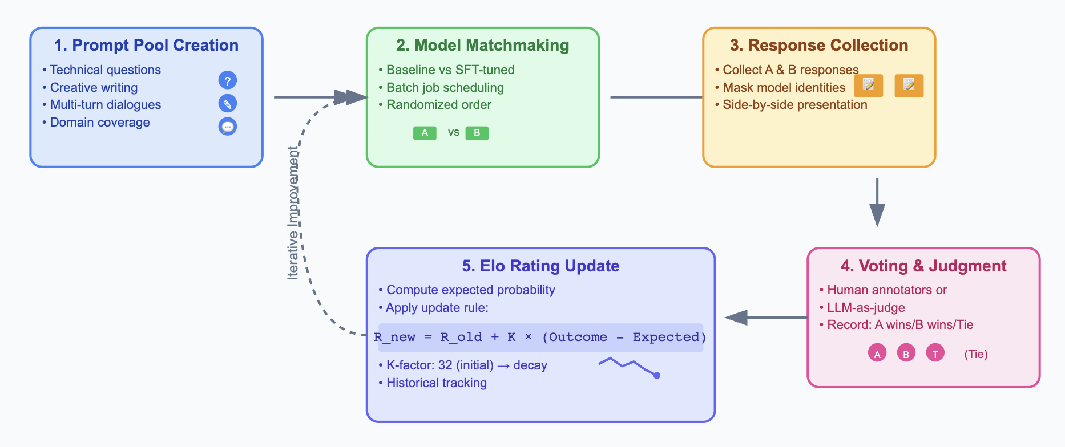
LLMsys Arena – Workflow

Slide 10
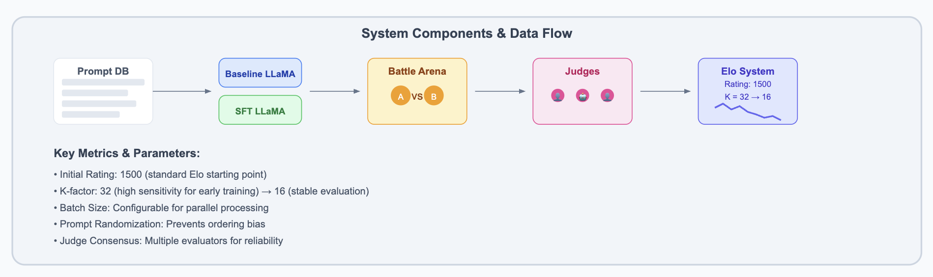
LLMsys Arena – Workflow

Slide 11


Elo Rating System Details
Expected Score Calculation
$E_{A}= \frac{1}{1 + {10}^{\frac{R_{B}− R_{A}}{400}}}$
$E_{B}=1−E_{A}$
Outcome Encoding
If Model A wins: $S_{A}$= 1, $S_{B}$ = 0
If Tie: $S_{A}= S_{B}= 0.5$
If Model B wins: $S_{A}= 0, S_{B}= 1$
Rating Update
$R_{A_{new}} = { R}_{A_{old}} + K × \left(S_{A}− E_{A}\right)$
$R_{B_{new}} = R_{B_{old}} + K × \left(S_{B}−E_{B}\right)$
Choose K based on sample size and stability: e.g., K = 32 for first 100 matches, K = 16 thereafter
Advantages in SFT Context
Provides a continuous metric of improvement vs. baseline and other SFT variants
Robust to noise: tie outcomes prevent huge swings
Enables leaderboard-style tracking of multiple model versions

Slide 12
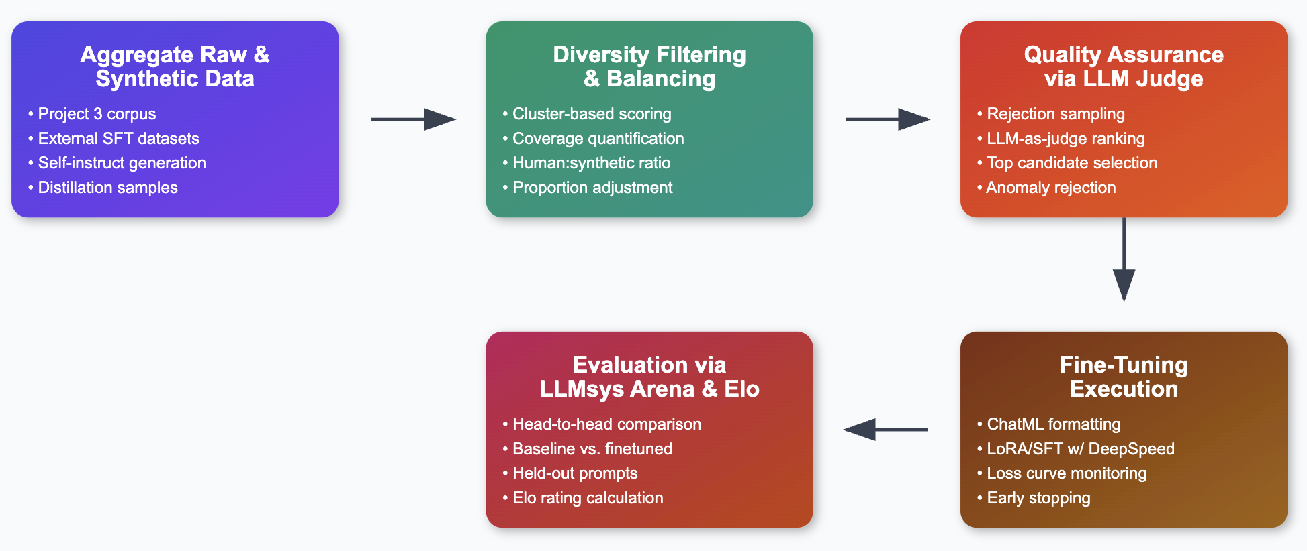
End-to-End SFT Part II Pipeline

Slide 13
Tools & Resources
Synthetic Data Generation
LabelYourData Article on Synthetic Data for LLM Fine-Tuning Label Your Data
Scale AI Paper: Synthetic Strategies for Enterprise Scale
Hugging Face Synthetic Data Generator (UI, no-code) Reddit
Gretel Navigator (Nvidia) for evolutionary synthetic examples WIRED
LLM-as-Judge & Rejection Sampling
ArXiv: “Unlocking Comprehensive Evaluations for LLM-as-a-Judge” (Feb 2025) arXiv arXiv
DeepSeek-V3 examples: rejection sampling with generative reward model Atla AI
LLMsys Arena & Elo
OpenLM.ai Chatbot Arena (recent platform launch) OpenLM.aiAnalytics Vidhya
ArXiv: Chatbot Arena / Elo methods (2023) LMSYS
Analytics Vidhya: “From GPT-4 to Llama 3 – Chatbot Arena Ranks” Analytics Vidhya
Implementation Frameworks
Hugging Face PEFT & transformers (LoRA, QLoRA, LowRA)
DeepSpeed & TRL packages (SFTTrainer, DPOTrainer)

Slide 14
References
LabelYourData. “Synthetic Data: Benefits and Techniques for LLM Fine-Tuning in 2025.” Jun 2024. Label Your Data
Yung-Chieh Chan et al. “Synthetic Data Generation Strategies for Fine-Tuning LLMs.” Scale AI Blog, Jan 2025. Scale
Zhang et al. “On the Diversity of Synthetic Data and its Impact on Training Large …” arXiv, Oct 2024. arXiv
Zhang & Wang. “Unlocking Comprehensive Evaluations for LLM-as-a-Judge.” arXiv:2502.12501, Apr 2025. arXiv arXiv
OpenLM.ai. “Chatbot Arena” (LLMsys Arena). May 2025. OpenLM.aiAnalytics Vidhya
Emanuilov et al. “Direct Preference Optimization (DPO) in Language Model Alignment.” UnfoldAI, Dec 2024.

Slide 15
Thank you

